Slide 1
What you need to know about Bootcamp now
CS 5010 Program Design Paradigms “Bootcamp”
MSCS Orientation 9/8/2015
© Mitchell Wand, 2012-2015
This work is licensed under a Creative Commons Attribution-NonCommercial 4.0 International License.
Notes:
Welcome to CS 50-10, Program Design Paradigms, also known as “Bootcamp”
I’m Professor Wand, and I will be your instructor in this online course.
In this lesson, we will learn about the goals of this course and about some of the educational philosophy behind it.

Slide 2
The Point of this course
1. It’s not calculus. Getting the right answer is not enough.
2. The goal is to write beautiful programs.
3. A beautiful program is one that is readable, understandable, and modifiable by people.

Slide 3

We want you to make your programs look like this:
source

Slide 4
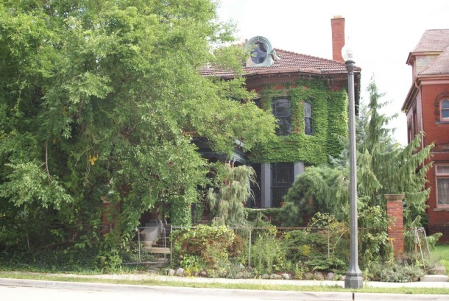
Not like this
source

Slide 5

Like this
source

Slide 6
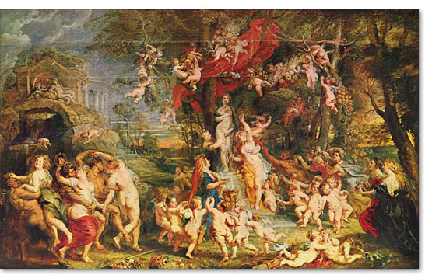
Not like this
source

Slide 7

And never, ever like this
source

Slide 8
The course web page
Your source for everything about 5010:
http://www.ccs.neu.edu/course/cs5010f15

Slide 9
"I am here"
Sign in to the course at:
This will tell us the information we need to know about you
http://bit.ly/cs5010f15-iamhere

Slide 10
Startup Schedule
Lectures start next week:
Lecture Section | First Meeting | Location | Notes
Tues aft (Boston) | Thu 9/17 | 106 WVG | Time and location of first meeting TBA
Tues eve (Boston) | Tue 9/15 | 220 SH
Tues eve (Seattle) | Tue 9/15 | Orcas 225
Wed eve (Boston) | Wed 9/16 | 220 SH

Slide 11
CS 5011
CS 5011 meets this week and next week only.
Go to ANY section you like.
This is an open lab to help you with whatever you need to get started
After that, 5011 will not meet; will be replaced by codewalk.

Slide 12
This course is probably different from anything you've had before

Slide 13
The "Flipped Classroom" model
The course consists of 13 modules, numbered 0 through 12.
Each module runs from Monday to Sunday
Each module consists of
online materials
a 2-hour classroom meeting
a problem set

Slide 14
Online Materials
The materials for each week will be posted online.
This will consist of a reading assignment and a set of online materials.
Lessons may consist of PowerPoint slides, video narrations, or live coding demonstrations.
This material replaces the usual 3-hour lecture
You will be responsible for studying this material before you come to class.

Slide 15
Guided Practices
Lessons may also include a few short exercises, called "Guided Practices"
These will give you a quick check on your understanding.
In some cases the exercises contain new material, so you won't get the whole story unless you do them.

Slide 16
How to study the materials
Practice active reading
DON'T SKIM!
read every word carefully
read with pencil in hand
jot down questions as you go along
if there's something you don't understand, STOP.
re-read the slide
replay the video
ask a question on Piazza
if you don't come to class with a question, you haven't read closely enough!!

Slide 17
The classroom meeting
The classroom meeting will be devoted to
review of the previous topics, as needed
in-class exercises and other enrichment on this week's materials
questions and answers.
No new material will be presented in class.

Slide 18
The Weekly Problem Set
Problem Sets are assigned weekly.
Problem Sets take a lot of work
designed to take 20 hrs/week
so plan your time accordingly

Slide 19
Codewalk
Problem Sets are due on Monday at 6pm local time.
Sometime later in the week, you will be examined orally on your solution for about 15 minutes.
This is called "codewalk."

Slide 20
Course Staff
Instructors:
Mitchell Wand
Will Clinger
Jim Miller
Head Tas
Jai Asher
Vishesh Yadav
Gabriel Bakiewicz
15 other TAs

Slide 21
Remember: It's not calculus
It's not enough to write programs that get the right answers.
We want you to write beautiful programs
It's about design– which means making your program readable and modifiable by humans
This includes documenting your program
so the TA can understand it
so a future programmer can understand and modify it

Slide 22
Questions?

